Slide 1
DFD
Data Flow Diagram

Slide 2
Creating Data Flow Diagrams
Steps:
Create a list of activities
Construct Context Level DFD
(identifies external entities and processes)
Construct Level 0 DFD
(identifies manageable sub process )
Construct Level 1- n DFD
(identifies actual data flows and data stores )
Check against rules of DFD

Slide 3
DFD Naming Guidelines
External Entity → Noun
Data Flow → Names of data
Process → verb phrase
  a system name
  a subsystem name
Data Store → Noun

Slide 4

Creating Data Flow Diagrams
Lemonade Stand Example

Slide 5
Creating Data Flow Diagrams
Example
Steps:
The operations of a simple lemonade stand will be used to demonstrate the creation of dataflow diagrams.
Create a list of activities
  Old way: no Use-Case Diagram
  New way: use Use-Case Diagram
Construct Context Level DFD
(identifies sources and sink)
Construct Level 0 DFD
(identifies manageable sub processes )
Construct Level 1- n DFD
(identifies actual data flows and data stores )

Slide 6
Creating Data Flow Diagrams
Example
Create a list of activities
Think through the activities that take place at a lemonade stand.
Customer Order
Serve Product
Collect Payment
Produce Product
Store Product

Slide 7
Creating Data Flow Diagrams
Example
Create a list of activities
Also think of the additional activities needed to support the basic activities.
Customer Order
Serve Product
Collect Payment
Produce Product
Store Product
Order Raw Materials
Pay for Raw Materials
Pay for Labor

Slide 8
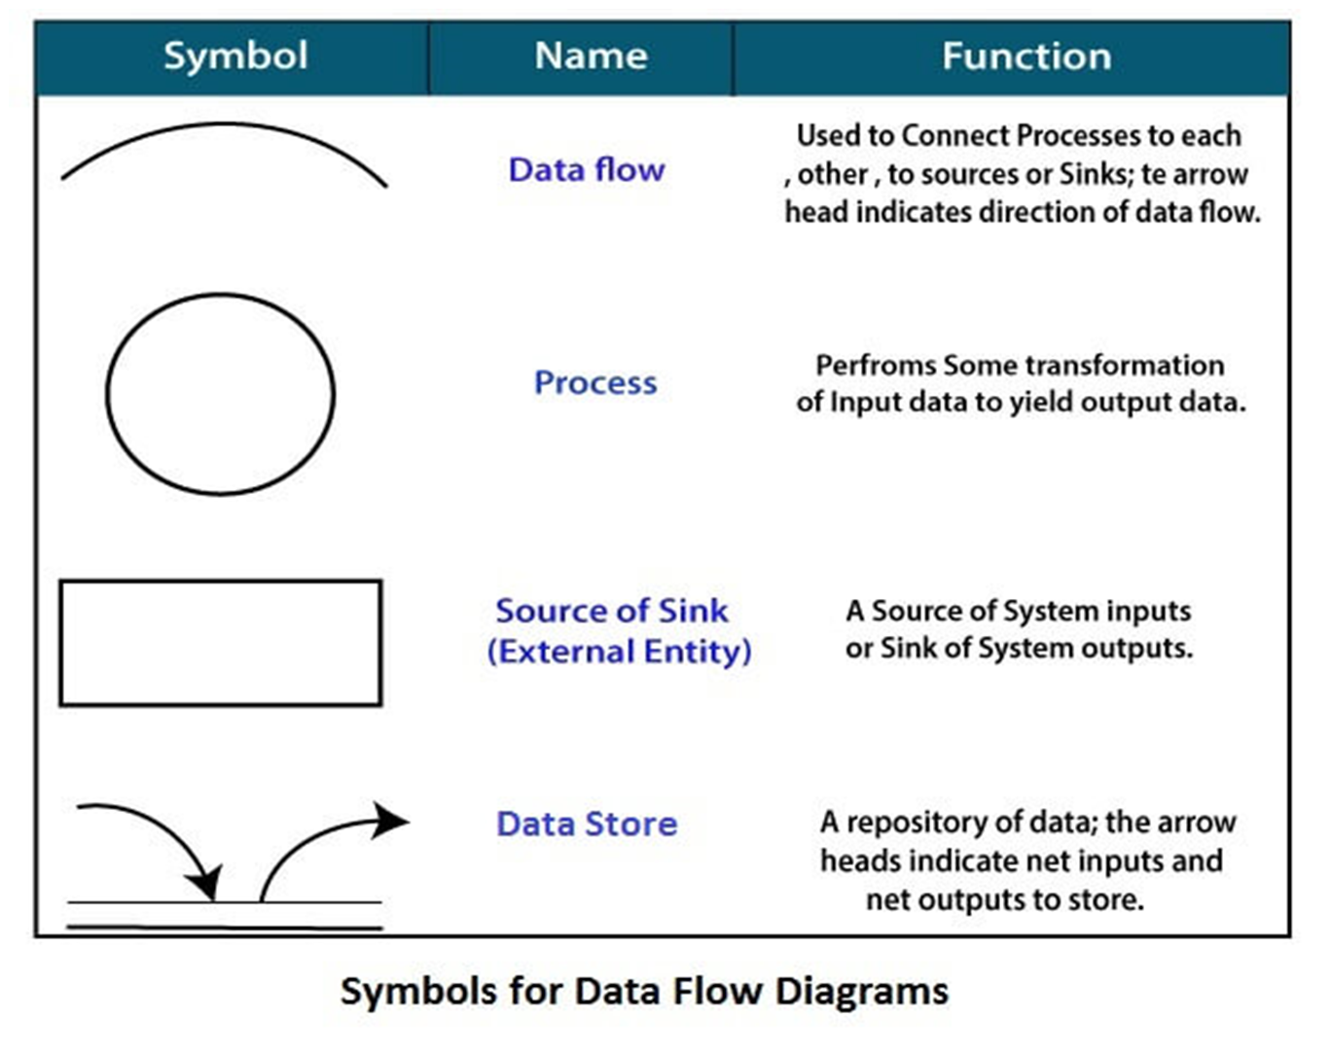

Slide 9
Creating Data Flow Diagrams
Example
Create a list of activities
Group these activities in some logical fashion, possibly functional areas.
Customer Order
Serve Product
Collect Payment
Produce Product
Store Product
Order Raw Materials
Pay for Raw Materials
Pay for Labor

Slide 10

Creating Data Flow Diagrams
Example
Construct Context Level DFD
(identifies sources and sink)
Create a context level diagram identifying the sources and sinks (users).
Context Level DFD
CUSTOMER
0.0
Restaurant System
Sales Forecast
EMPLOYEE
Order
Customer Order
Serve Product
Collect Payment
Produce Product
Store Product
Order Raw Materials
Pay for Raw Materials
Pay for Labor
Production Schedule
Product Served
Pay
Payment
Time Worked
Received Goods
Payment
Purchase Order
VENDOR

Slide 11
Creating Data Flow Diagrams
Example
Construct Level 1 DFD
(identifies manageable sub processes )
Create a level 0 diagram identifying the logical subsystems that may exist.
Level 1 DFD
1.0
Sale
Customer Order
Serve Product
Collect Payment
Produce Product
Store Product
Order Raw Materials
Pay for Raw Materials
Pay for Labor
Customer Order
Sales Forecast
Product Ordered
CUSTOMER
Payment
2.0
Production
EMPLOYEE
Production
Schedule
Product Served
Received Goods
Inventory
VENDOR
3.0
Procure-ment
Purchase Order
Order
Decisions
Payment
Pay
Time Worked
4.0
Payroll

Slide 12


Creating Data Flow Diagrams
Example
Construct Level 2- n DFD
(identifies actual data flows and data stores )
Create a level 1 decomposing the processes in level 0 and identifying data stores.
Level 2 DFD
CUSTOMER
Customer Order
Customer Order
Serve Product
Collect Payment
Produce Product
Store Product
Order Raw Materials
Pay for Raw Materials
Pay for Labor
ORDER
Request for Forecast
1.1
Record Order
1.3
Produce Sales Forecast
Severed Order
Payment
Sales Forecast
1.2
Receive Payment
PAYMENT

Slide 13


Creating Data Flow Diagrams
Example
Construct Level 2 (continued)
Create a level 1 decomposing the processes in level 0 and identifying data stores.
Level 2 DFD
Product Order
ORDER
Customer Order
Serve Product
Collect Payment
Produce Product
Store Product
Order Raw Materials
Pay for Raw Materials
Pay for Labor
2.1
Serve Product
Quantity Severed
RAW MATERIALS
Production
Schedule
2.2
Produce Product
Quantity Used
INVENTORTY
Production Data
2.3
Store
Product
Quantity Produced & Location Stored

Slide 14




Creating Data Flow Diagrams
Example
Construct Level 2 (continued)
Create a level 1 decomposing the processes in level 0 and identifying data stores.
Level 2 DFD
Order Decision
3.1
Produce Purchase Order
PURCHASE ORDER
Customer Order
Serve Product
Collect Payment
Produce Product
Store Product
Order Raw Materials
Pay for Raw Materials
Pay for Labor
Quantity On-Hand
RAW MATERIALS
Quantity
Received
Received Goods
3.2
Receive Items
RECEIVED ITEMS
Payment Approval
3.3
Pay Vendor
VENDOR
Payment

Slide 15

Creating Data Flow Diagrams
Example
Construct Level 2 (continued)
Create a level 1 decomposing the processes in level 0 and identifying data stores.
Level 2 DFD
Time Worked
4.1
Record Time Worked
TIME CARDS
Customer Order
Serve Product
Collect Payment
Produce Product
Store Product
Order Raw Materials
Pay for Raw Materials
Pay for Labor
Employee ID
EMPLOYEE
Payroll Request
4.2
Calculate Payroll
Unpaid time cards
PAYROLL
Payment Approval
4.3
Pay Employee
PAYMENTS
Payment

Slide 16
Process Decomposition
1.0
Sale
1.1
Record Order
1.2
Receive Payment
2.0
Production
2.1
Serve Product
2.2
Produce Product
2.3
Store
Product
0.0
Lemonade System
3.0
Procure-ment
3.1
Produce Purchase Order
3.2
Receive Items
3.3
Pay Vendor
4.0
Payroll
4.1
Record Time Worked
4.2
Calculate Payroll
4.3
Pay Employee
Context Level
Level 1
Level 2

Slide 17
DFD Example: Bus Garage Repairs
Buses come to a garage for repairs.
A mechanic and helper perform the repair, record the reason for the repair and record the total cost of all parts used on a Shop Repair Order.
Information on labor, parts and repair outcome is used for billing by the Accounting Department, parts monitoring by the inventory management computer system and a performance review by the supervisor.

Slide 18
DFD Example: Bus Garage Repairs (cont’d)
External Entities: Bus, Mechanic, Helper, Supervisor, Inventory Management System, Accounting Department, etc.
Key process (“the system”): performing repairs and storing information related to repairs
Processes:
  Record Bus ID and reason for repair
  Determine parts needed
  Perform repair
  Calculate parts extended and total cost
  Record labor hours, cost

Slide 19
DFD Example: Bus Garage Repairs (cont’d)
Data stores:
  Personnel file
  Repairs file
  Bus master list
  Parts list
Data flows:
  Repair order
  Bus record
  Parts record
  Employee timecard
  Invoices

Slide 20
Bus Garage Context Diagram
Bus
Mechanical problem
to be repaired
Fixed mechanical
problems
Repair summary
Supervisor
Helper
Labor
Bus Repair Process
System
List of parts used
Inventory Management System
Labor
Labor, parts cost details
Mechanic
Accounting

Slide 21
CSUB Burger’s Order Processing System
Draw the CSUB Burger’s context diagram
  System
    Order processing system
  External entities
    Kitchen
    Restaurant
    Customer
  Processes
    Customer order
    Receipt
    Food order
    Management report

